Slide 1

Sprocket Central Pty Ltd
Data analytics approach
Pranay Kumar

Slide 2
Agenda
Introduction
Data Exploration
Model Development
Interpretation

Slide 3
Introduction
Identify & Recommending High Value Customers
Outline Of Problem
Sprocket Central is a company that specializes in high-quality bike and accessories
Marketing team is looking to boost sales
To Target 1000 new customers that will bring highest value to business
Approach For Data Analysis
Bike related purchases for last 3 years based on gender
Top industries contributing maximum profit and related sales
Wealth by Age Category
No of cars owned in each state
Customer Classification

Slide 4
Data Exploration
Data Quality Assessment
Key issue dealt with for data quality issue:
 | Accuracy | Completeness | Consistency | Currency | Relevancy | Validity
Customer Demographic | DOB: Inaccurate Age: Missing | Job Title: Blank Customer Id: incomplete | Gender: Inconsistent | Deceased Customer: Filtered out | Default column: Delete
Customer Address |  | Customer Id: incomplete | States: Inconsistent
Transactions | Profit: Missing | Customer Id: incomplete Online Orders: Blank Brands: Blank |  |  | Cancelled Status Order: Filtered Out | List Price: Format Product Sold Date: Format

Slide 5
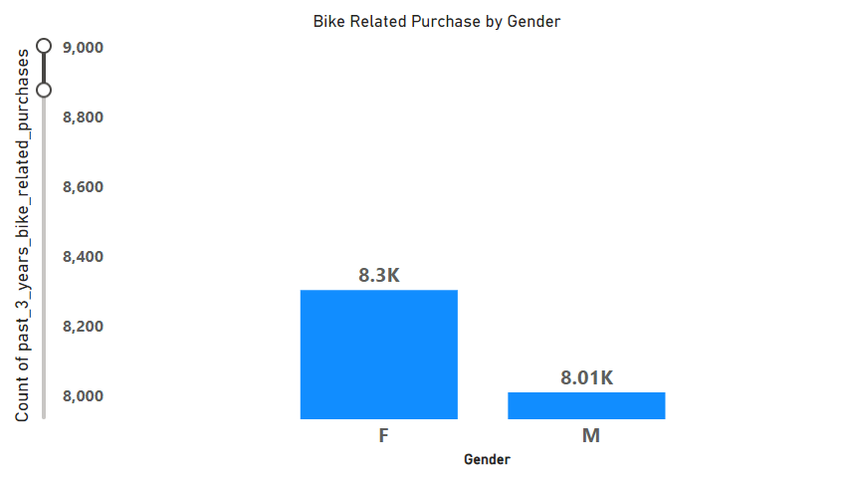
Data Exploration
Bike Related Purchase Over Last 3 Years based on Gender
Data Shows, on average females have made more bike related purchases compared to males
On average females have had 2% higher bike related purchases compared to men
Place any supporting images, graphs, data or extra text here.

Slide 6
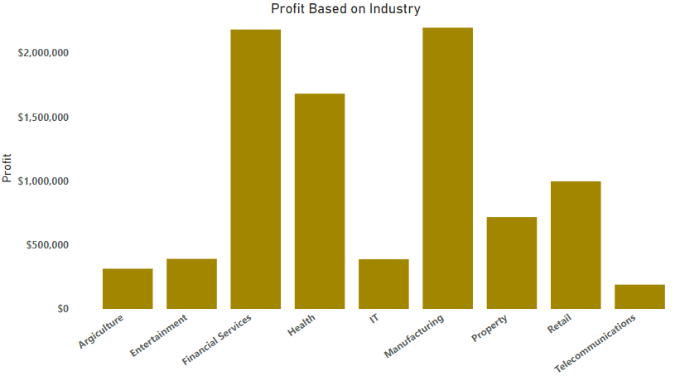
Data Exploration
Top Industry Contributing to Maximum Profit & Bike Related Purchases
Top 3 industry bringing in high profit are: Financial services, Health & Manufacturing
These can be obvious as most of these industry sectors are based within the city or on outskirts of city therefore consumers prefer bikes for commuting
Most of the Industry Sectors have returned less than $1,000,000 in profits

Slide 7
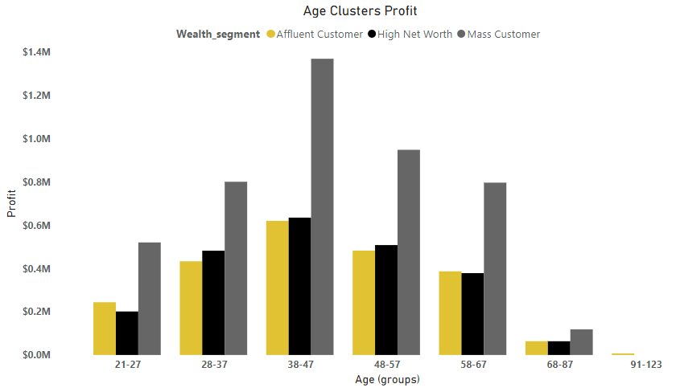
Data Exploration
Profit of Wealth Segment by Age Groups
Overall, Mass customer segmentation makes highest profit across different age clusters.
Mass Customer Aged between 38-47 are likely to bring more profit for company compared to others.
This also indicates trend of buying power, as it increases over time till 47& then sees a decline in buying power, thus leading to lower profits.

Slide 8
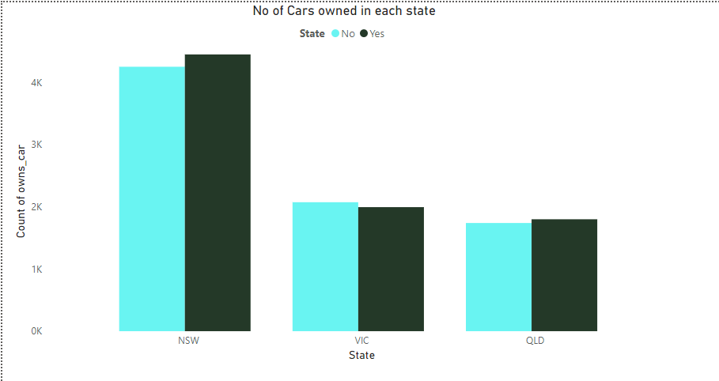
Data Exploration
Number of Cars owned in each State
NSW, VIC & QLD could be potential market opportunities for the company
NSW has highest potential as the number of people that own car is almost equal to people who don’t own car which shows that there is opportunity to find value customers there

Slide 9
Model Development
Customer Classification – Targeting High Value Customers
These are high value customers that should be targeted from new list:
Most of High Value Customers will be female compared to male
Working in Financial services, Health and manufacturing industry sector
Aged between 38-47
Who are currently living in NSW,VIC

Slide 10
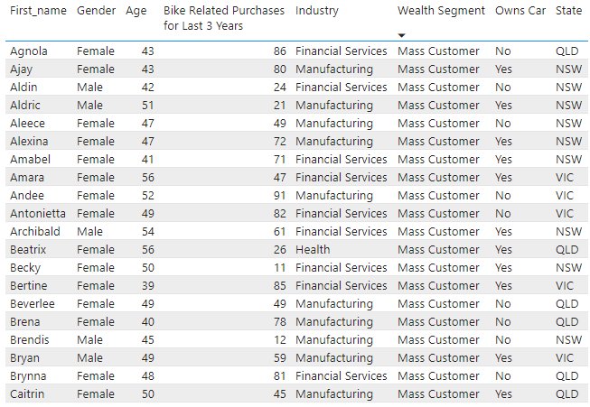
Interpretation
Summary Table for High Value Customers
Here is snapshot of few customer that will come under high value customer classification

Slide 11
Thank You

